Slide 1
Data 622: Machine Learning and Big Data
Assignment 4
Dirk Hartog

Slide 2
The Problem and Approach
Can customers be segmented into groups to uncover patterns to modify products according to the specific needs, behaviors and concerns of different customer types?
Source
Customer Personality Analysis from Kaggle
https://www.kaggle.com/datasets/imakash3011/customer-personality-analysis/data
The Approach:
Exploratory Data Analysis
KMeans clustering technique to segment data
Improve model with dimensionality reduction using Principal Component Analysis (PCA)
Summarize results

Slide 3
Exploratory Data Analysis
Initial data set contained 2,240 customer observations with 29 features, with no missing values
Features
Categorical data
Marital status
Education status
Whether or not promotions were accepted
Yes or No if the customer complained within the past two years
Continuous/Numerical
Birth year
Income
Teens at home
Kids at home
Amount spent on meats, fish, sweets, wine, gold
Purchases made with deals
Number of purchases made on the web, catalog, store
Number of websites visited
Notes:
Before a model could be built, an exploratory data analysis was performed to get a better understanding of the data. This was important to not only help guide and inform what clustering technique should be used but also to make sure any pre processing steps were performed before fitting the model with the data.

Slide 4
Exploratory Data Analysis
Columns were re-labeled for clarity
Additional columns were created from existing columns
Children (No. teens + No. kids)
Age (The year - their birth year)
Total Spending (meats + fish + sweets + wine + gold)
Values in two categorical columns were re coded into two levels
Education (5 → 2)
Postgraduate or graduate
Marital Status (6 → 2)
Single or Couple
Notes:
Before a model could be built, an exploratory data analysis was performed to get a better understanding of the data. This was important to not only help guide and inform what clustering technique should be used but also to make sure any pre processing steps were performed before fitting the model with the data.

Slide 5
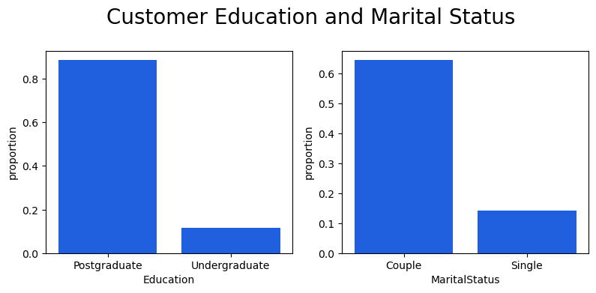
Notes:
The next few slides are some visualizations of the proportion of customers within each category, which are summarized in later slides

Slide 6
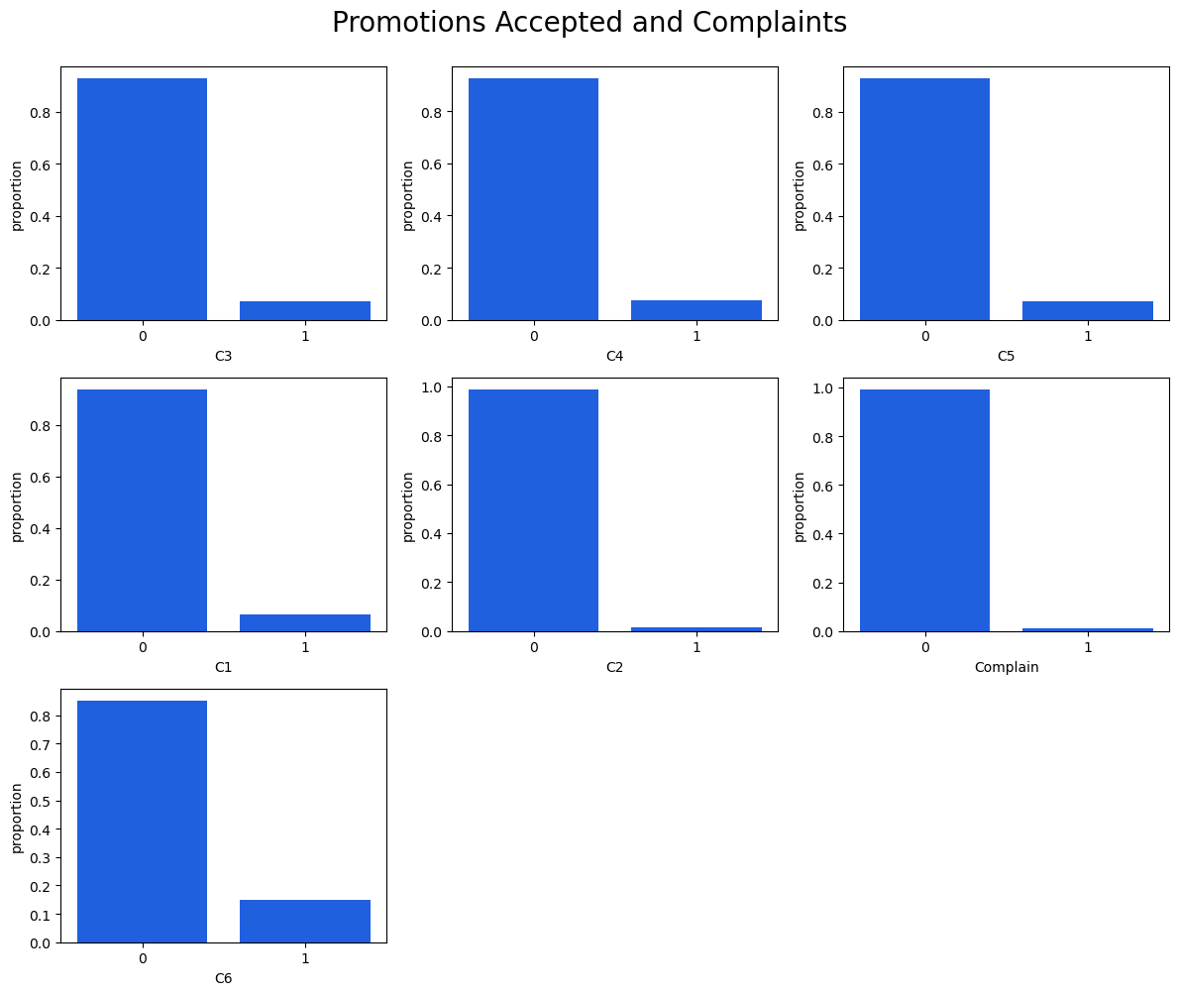

Slide 7
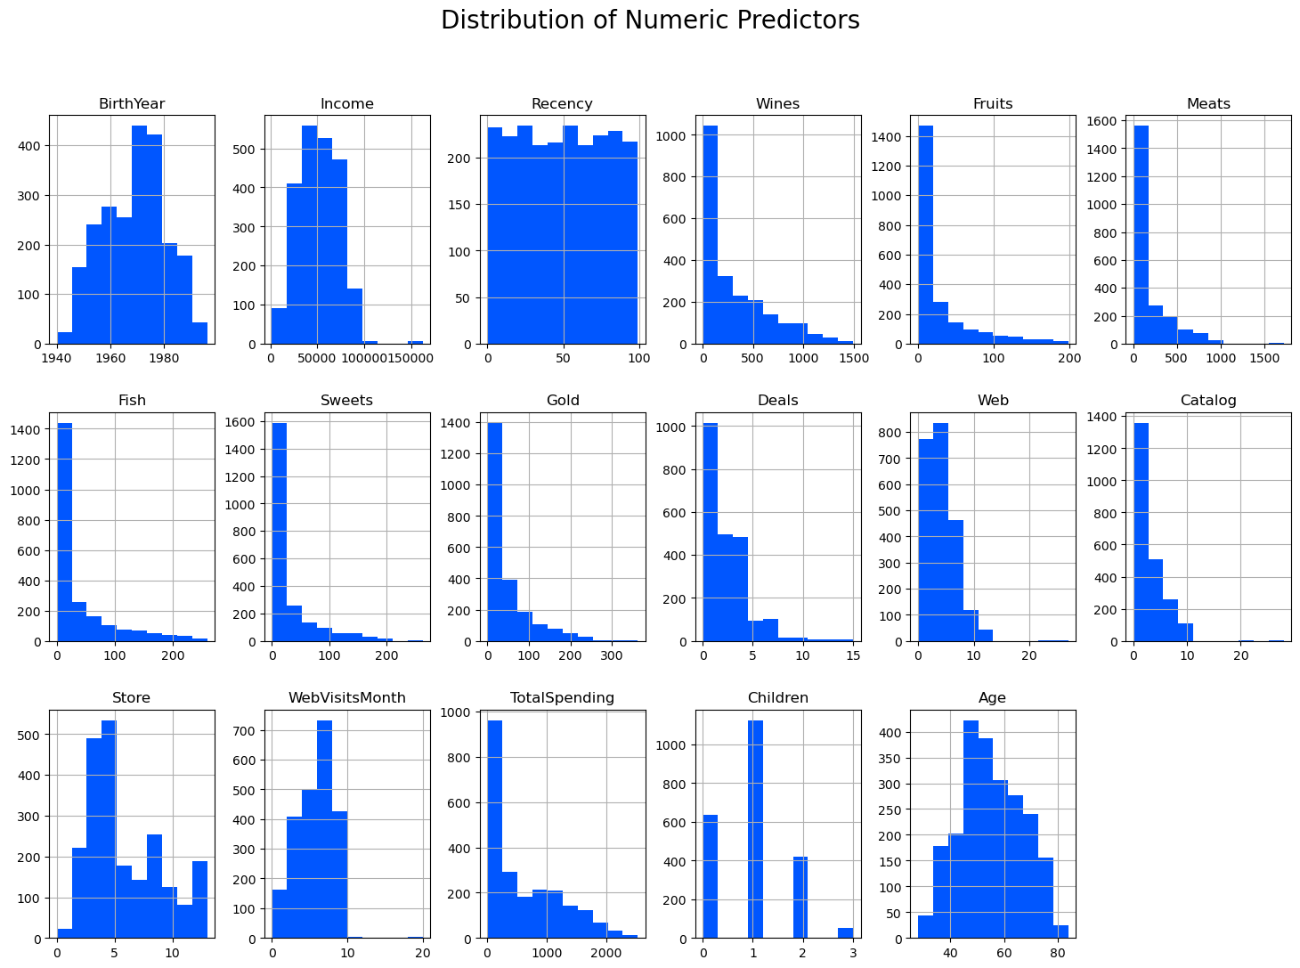
Notes:
When looking at the distributions of the continuous variables we can see that most are skewed to the right, indicating high leverage outliers.

Slide 8
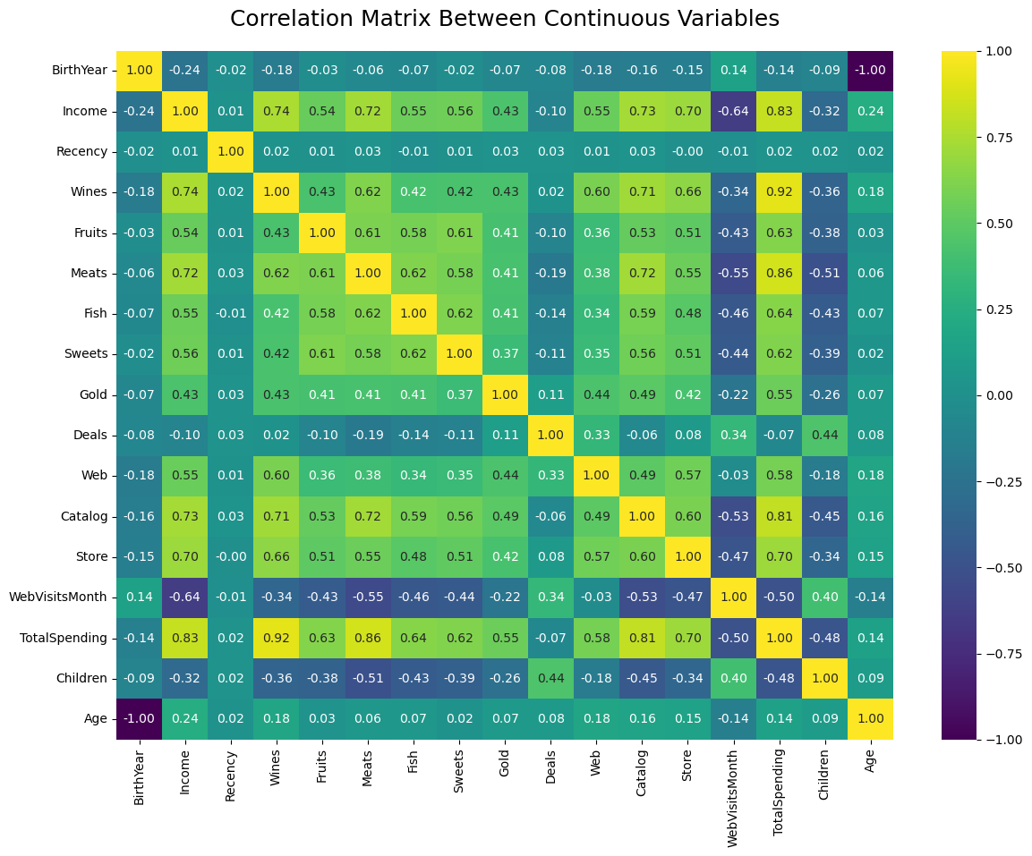
Notes:
To reveal the relationships between the continuous variables in our data, I created a heatplot.
Some of the highest correlations in our data were between a customers income and type of product purchased, as well as income and the place where purchases were made.

Slide 9
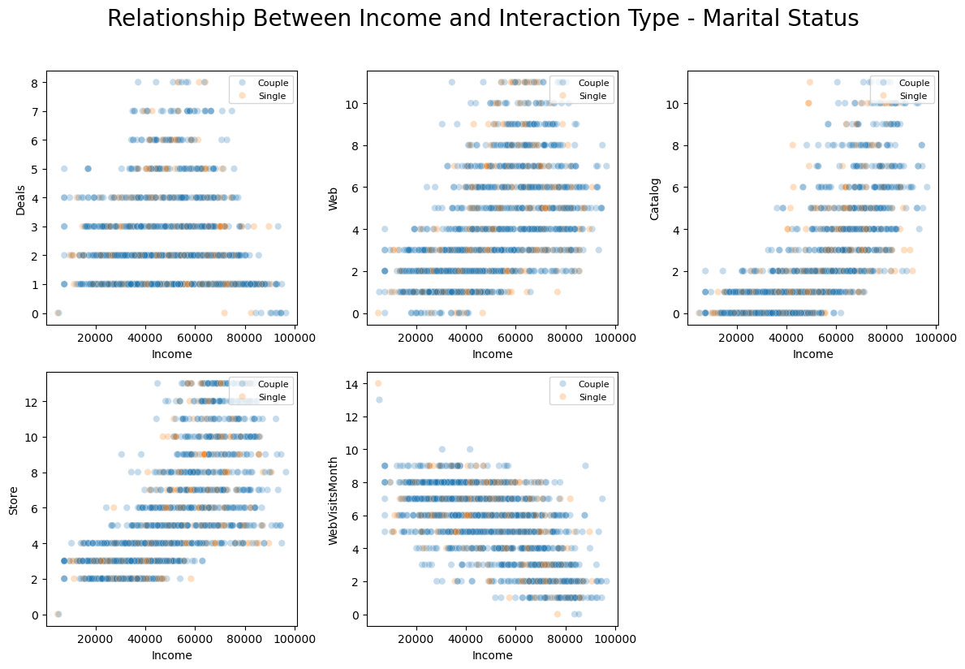
Notes:
I decided to look at scatter plots adding in the layer of a marital status and level and Education. Understanding where individuals with different incomes are making the most purchase might be helpful in decided where to emphasize higher or lower cost products. While the data is pretty spread across incomes, there are some trends that emerge when looking at these plots. As income increases, purchases made in a store or catalogs increases.

Slide 10
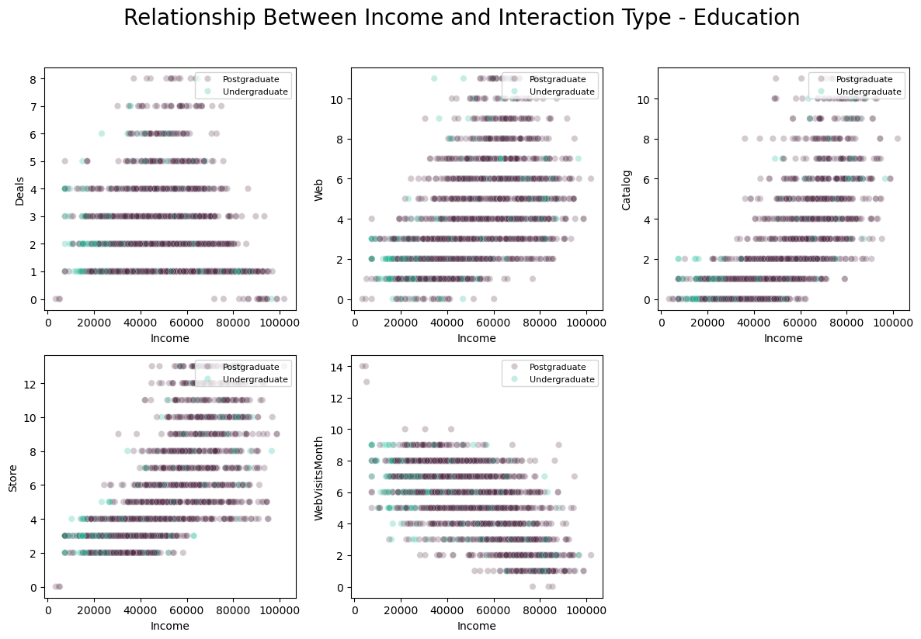
Notes:
Adding in the layer of either Education as shown here or Marital status as shown in the previous slide did not reveal any obvious clusters. This may have been from the dominance of one group over the other.

Slide 11
K Means Clustering
Unsupervised learning technique to divide data
Data only included the continuous variables
Preprocessing steps:
Remove Outliers
Scaled the data through standardization
There was no missing data
Calculated silhouette scores to find the optimal number of clusters
A model was built with the scaled data using the optimal number of clusters from above
Notes:
K Means clustering is an unsupervised technique that separates unlabeled data into different groups. While this method is best suited for data where clusters are well separated it was determined that this technique would still be beneficial in identifying clusters within the data I used. The strong relationships between income and several other features provided some evidence that there might be two income based clusters that would be delineated using this technique.
Preprocessing steps were taken as listed in the slide.

Slide 12
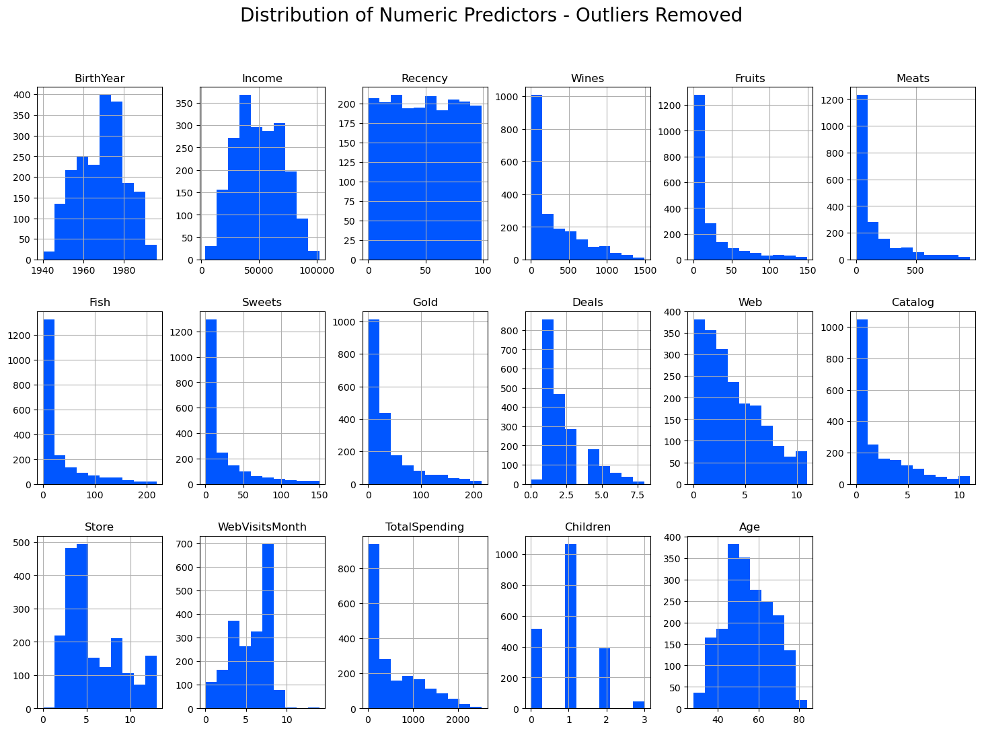
Notes:
Since several of the features had strong outliers, these were removed leaving us with 2017 customers. Removing the outliers did not drastically change the data too much but my thought was that removing outliers provided a better representation of the majority of the customers.

Slide 13
Summary: Customer demographics
Average age | 55 (28 - 84)
Average Income | $49,996.80 (3,792 - 101,970.00)
Education | 88.2% have received post graduate education
Marital Status | > 82% are a couple (Married or Together)
Number of Children | Median number of children was 1
Days since last purchase | 50 days (0 - 99)
*After outliers removed
Notes:
The next three slides show summaries of the customera in the data set that was provided to the KMeans model

Slide 14
Summary: Promotions
Acceptance rates through all 6 campaigns ranged from 2-15%
Campaign 6 had the highest acceptance rate (14.3%)
Campaign 2 lowest accepted rate (1.5%).
Purchases made with a deal ranged from 0 - 8, with an average of 2/customer
*After outliers removed

Slide 15
Summary: Spending Habits - Place and Products
Product | Avg. Spent
Wine | $289.50
Fruits | $20.9
Sweets | $21.30
Meats | $145.33
Fish | $30.66
Gold | $38.80
Place | Avg. Purchases
Web | 4
Store | 5.6
Catalog | 2.4
We visits | 5.5
Notes:
Here we can look at the

Slide 16
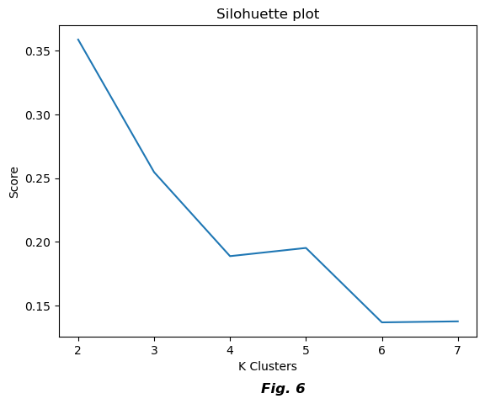
Notes:
This bring us to building the KMeans model. Several models were trained using a range of clusters between 2-7 to obtain the silhouette scores, which indicate how close the data points in each cluster are to one another. A higher score indicates closeness within the cluster.. The silhouette score was the preferred method over using the elbow method in finding the optimal number of K-clusters since the original data was not very clustered to begin with.
Silhouette score of 0.36, indicates how close the data points in each cluster are to on another.
This score is calculated by measuring each data point similarity to the cluster it belongs to and how different it is from other clusters.

Slide 17
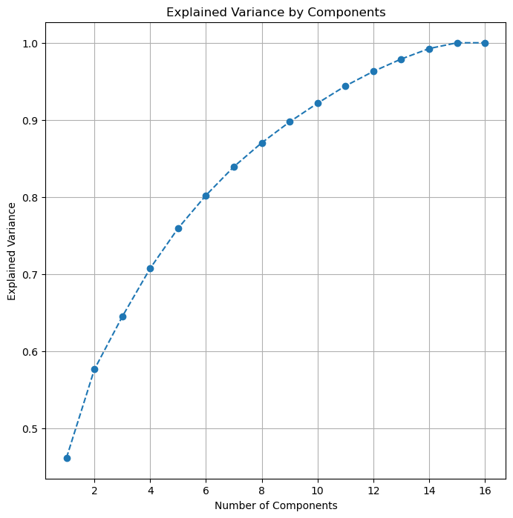
K Means Clustering With PCA
*
Notes:
To improve upon our model Principal Component Analysis was used to reduce dimensions in attempt to better define the clusters.
Looking at the amount of variance explained by the number of components, I chose to use 6 components as that preserved 80% of the variability in the data.

Slide 18
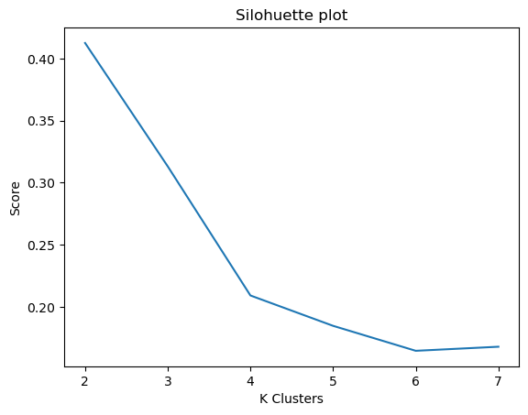
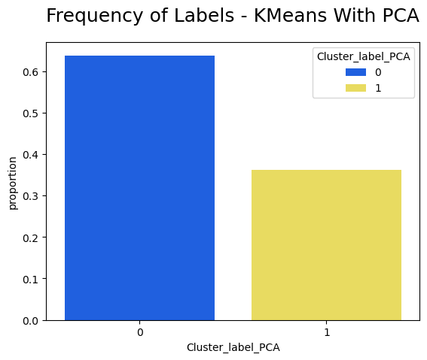
Notes:
After performing the dimensionality reduction technique to improve clustering and fitting the principal component scores to a new KMeans model using the silhouette score to find the optimal K, which was still 2 We could start analyzing the clusters. About 63% of values were labeled as belonging to cluster 0, and the rest to cluster 1

Slide 19
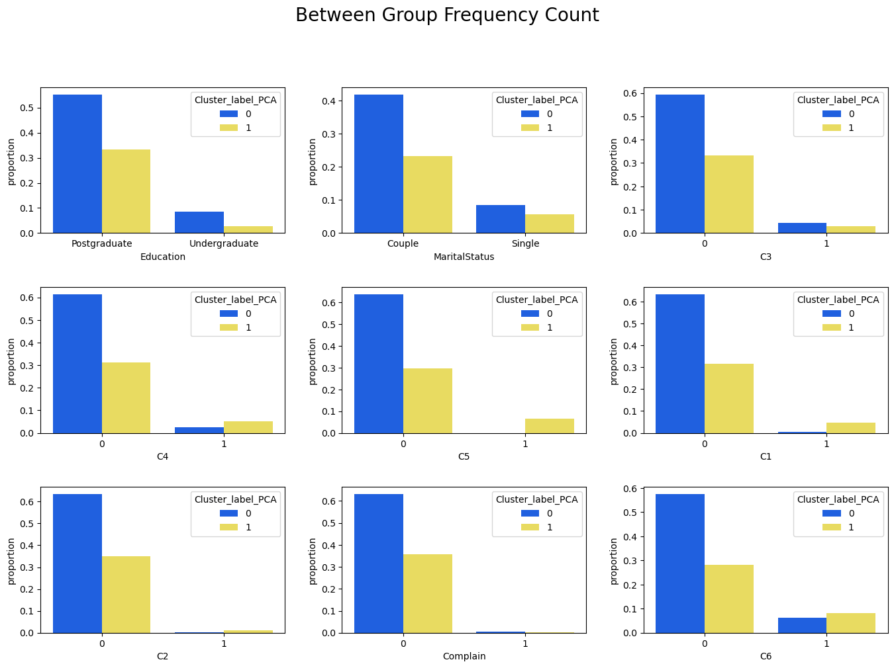
Notes:
The proportion of higher educated customers and those in a couple relationship in each cluster were similar. The customers in cluster 1 accepted promotions more often the those in cluster 0.

Slide 20
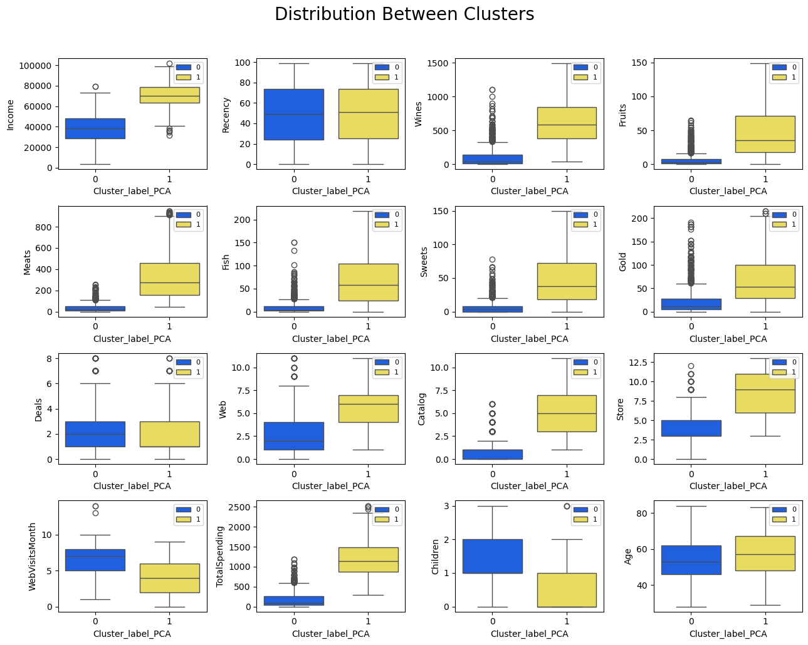
Notes:
Label 0 > Label 1

Slide 21
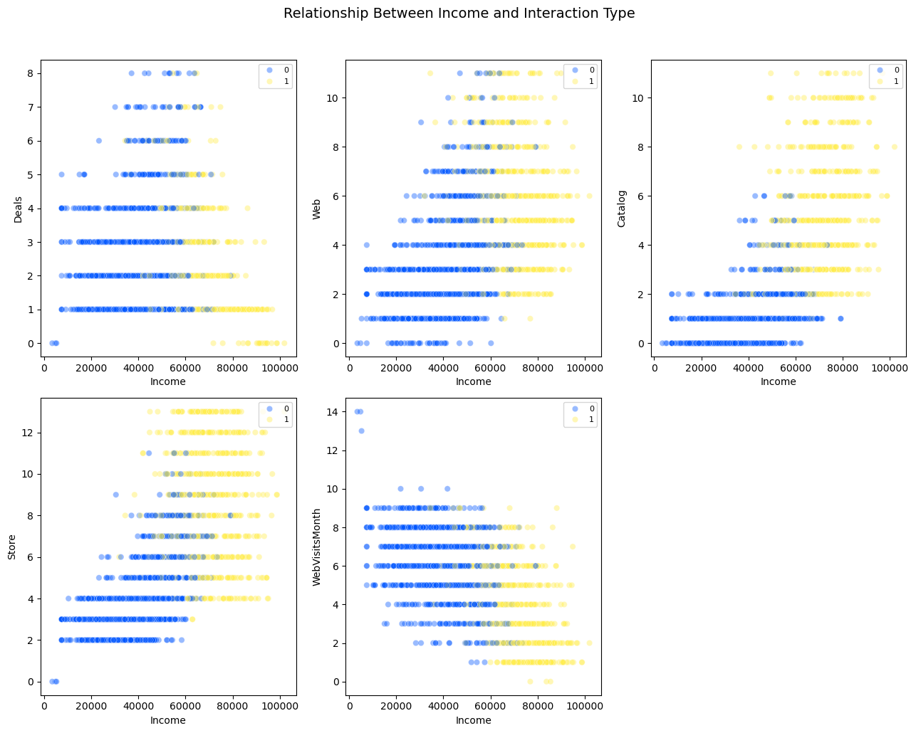
Notes:
In this scatter plot we can see the trend in income and number of purchases made at each place as well as number of visits to the website.

Slide 22
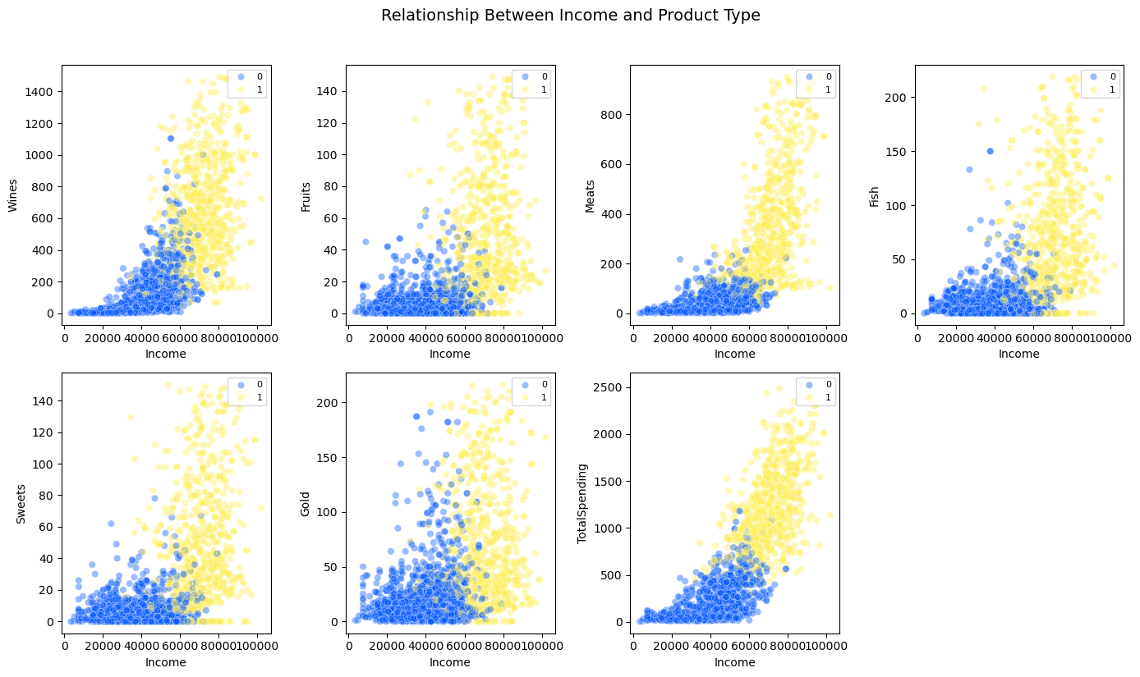
Notes:
In this scatter plot we can see the trend in income and the amount spent on each item as well as the total spending.

Slide 23
Patterns and Insights - Products and Places
 | Cluster Label
 | Cluster 0 | Cluster 1
Age | 54 | 57
Children | 1-2 | 0-1
Income Range | $3,502 - 79,146 | $31,907 - $101,970
Education | 86.7% Higher Ed. | 92.3% higher ed
Campaigns Accepted | Customers in cluster 1 accepted more promotions overall

Slide 24
Patterns and Insights - Products and Places
 |  | Average Spending
 |  | Meats | Wines | Fish | Sweets | Fruits | Gold | Deals | Total Spending
Cluster Label | 0 | 35.23 | 99.63 | 9.10 | 6.09 | 6.13 | 21.49 | 2.42 | 177.68
 | 1 | 339.44 | 624.35 | 68.69 | 48.11 | 46.96 | 69.36 | 1.98 | 1196.91

Slide 25
Patterns and Insights - Products and Places
 |  | Average Purchases
 |  | Store | Web | Catalog | Web Visits/Month
Cluster Label | 0 | 3.9 | 2.9 | 0.8 | 6.7
 | 1 | 8.7 | 5.8 | 5.1 | 3.8

Slide 26
Patterns and Insights
The needs and resources of cluster 0 who have more children and lower incomes might be different.
Campaigns may need to be adjusted to target these individuals especially since they make up the majority of our customers. This may help to drive up sales.
The proportion of accepted campaigns were quite low for both clusters but cluster accepted more of them
Alternative Marketing strategies or promotion strategies should continue to be explored
The top selling items are meats and wines.
The amount spent on these items had a high to moderate correlation so placing them together might maintain or continue to grow their sales
Cluster 0 visited the web site more times per month but web sales were lower among this group
Investigating what items and promotions are on the website to target the most frequent visitors might help to further understand how to target those customers and again improve sales from thai source.

Slide 27
Conclusions
Customer segmentation can be a powerful tool to unlock insights about customer behavior.
Clustering techniques are easy to implement
Reducing dimensions can be helpful to improve the ability to cluster the data by removing noise but at the same time keeping relevant information

